Slide 1
Achieve Remarkable Results SAP NetWeaver BW Powered by SAP HANA
Pulse Check: Collecting the Data in the Current BW Environment

Slide 2
Detailed Prerequisite Pulse Check - Overview
How to conduct a Pulse Check:
Review step-by-step instructions in this deck with customers
Have customers collect data for:
DSO activations
InfoCube load times
InfoCube size (database space used)
Query performance
Aggregates created
Use resulting data in Pulse Check Calculator to estimate performance benefits
Present final results to customer

Slide 3
Detailed Pulse Check Steps - Getting Started
Create a userid with authorizations for following transactions:
RSRT, ST12, SE16, ST05, ST03, ST02, RSRCACHE, RSDDSTAT
Indentify BW administrator and Basis contact familiar with environment
Create a list of maximum 10 DSOs with long-running activations
Create a list of maximum 10 long-running queries that have significant business impact
Create a list of maximum 10 largest InfoCubes (database size)
Create a list of maximum 20 largest aggregates (on any infocubes) --optional
Activate statistical data on query/Info Cube level 4 weeks prior Pulse Check to capture ample statistics for query performance

Slide 4
Evaluating DSO Activations

Slide 5
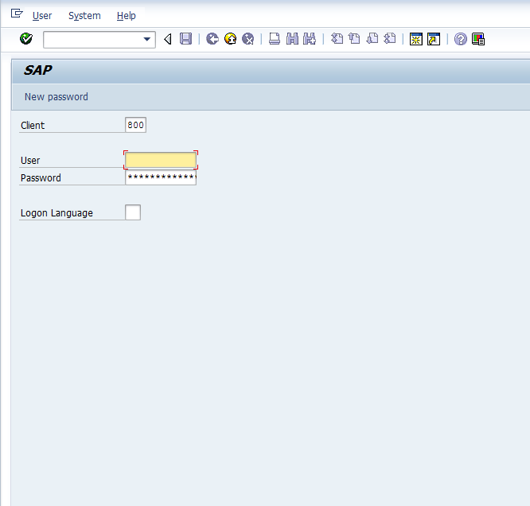
Logon to Customer System
Log onto the customer environment with appropriate access to the BW Admin Workbench

Slide 6
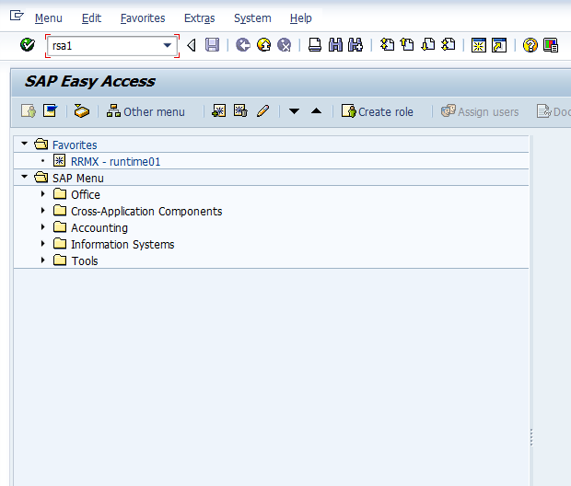
Execute Transaction RSA1
To enter the Administrator’s Workbench, enter transaction code RSA1 and press Enter.

Slide 7
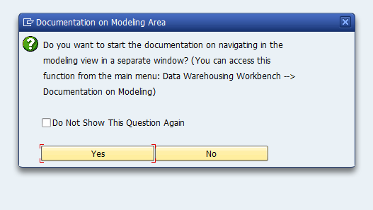
Entering the Admin Workbench
If this message appears in the customer’s system, bypass it by choosing “Yes”.

Slide 8
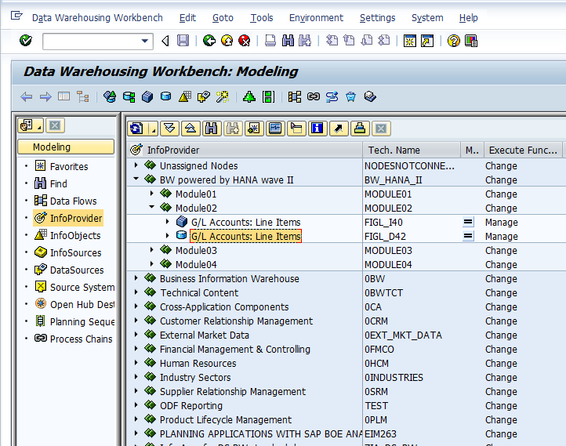
Inside the Administrator Workbench
Be sure to have selected “Modeling”, then “InfoProviders”.
Locate the customer’s DSOs which have long-running activation times.
In this example, “G/L Accounts: Line Items” is selected.

Slide 9
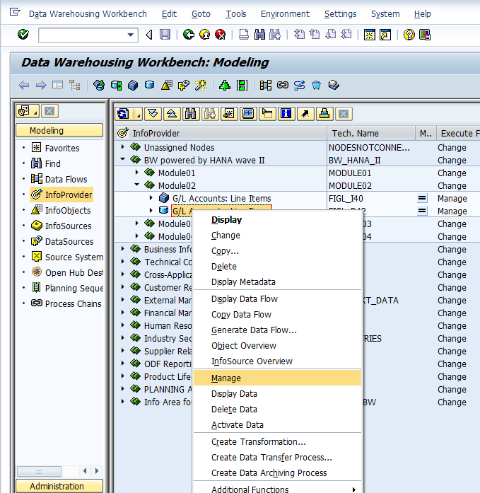
Inside the Administrator Workbench
Right Mouse Click (RMC) on the DSO to be evaluated and select “Manage”…

Slide 10
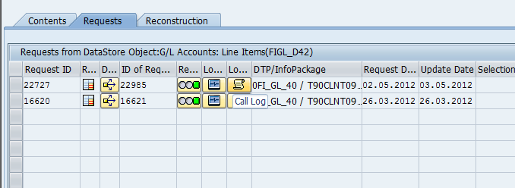
Inside the Administrator Workbench
Once “Manage” has been selected, you will see all the available Requests that have been loaded. Select the Call Log for the long-running request.

Slide 11
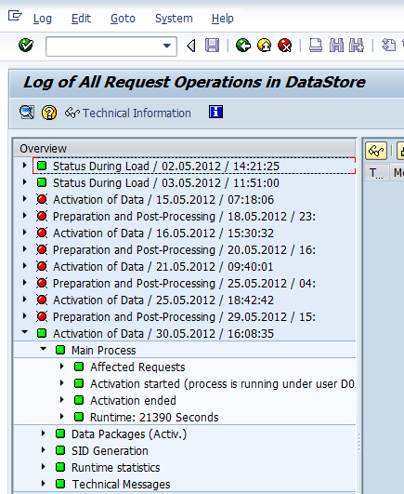
Inside the Activation Logs…
Once the log screen has been opened, choose a recent “Activation of Data” step and open the tree to “Main Process”.
At the bottom of the Main Process tree, you will see the Runtime of the DSO activation displayed. In this example, the activation time is 21390 seconds, which is almost 6 hours.
Record the values of the DSO activations for each DSO evaluated. These values will be used to calculate probable improvements on HANA.

Slide 12
Evaluating InfoCube Load Times

Slide 13
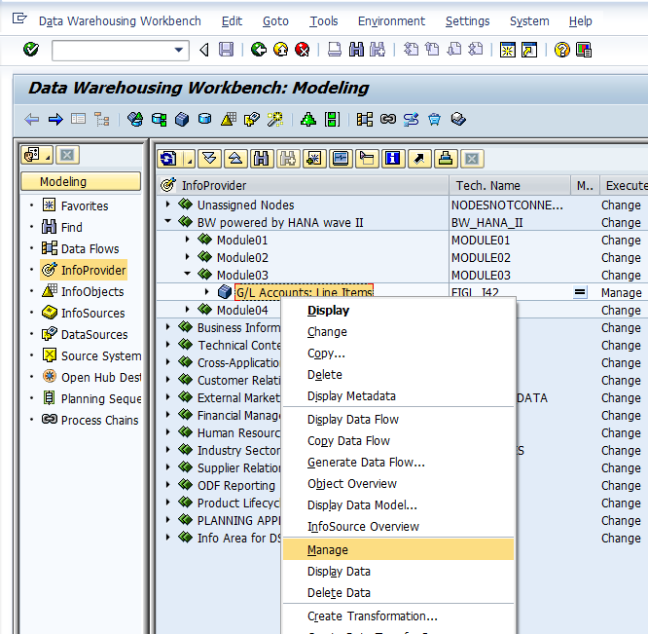
Inside the Administrator Workbench
For each of the large InfoCubes to be evaluated, take the following steps:
Right Mouse Click (RMC) on the InfoCube to be evaluated and select “Manage”…

Slide 14
Inside the Administrator Workbench
Once “Manage” has been selected, you will see all the available Requests that have been loaded. Select the Monitor for the request.

Slide 15
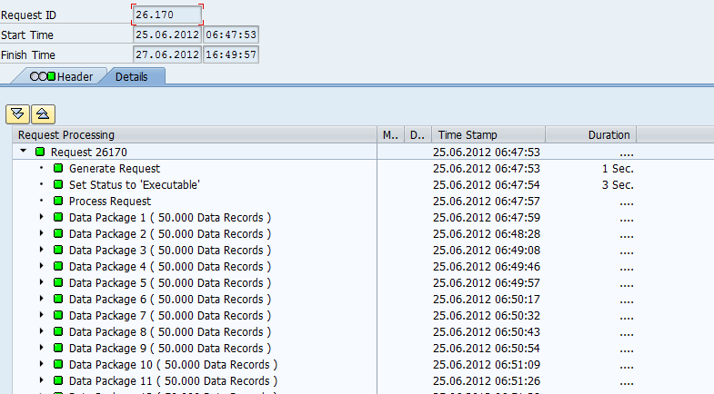
Evaluating the load
Note the start time on the Time Stamp. In this case, the request began at 06:47.

Slide 16
Evaluating the load
Left Mouse Click under “Duration”, the system will display the duration of time required to process the entire request. In this example, 2 Days+, however, this is an inaccurate depiction of actual InfoCube loading time, as it includes the requirement to change/update statuses of the load. Do not rely on this value; instead take the next step…

Slide 17
Evaluating the load
Scroll to the bottom of the Request to find “End of Main Process”. Note the end time. In this example, it’s 08:57.
Effectively, the amount of time required to load the data packages into the InfoCube was 2:10. (06:47 → 08:57).
Note this duration value down for each InfoCube being evaluated for further analysis.

Slide 18
Determining the Size of InfoCubes

Slide 19
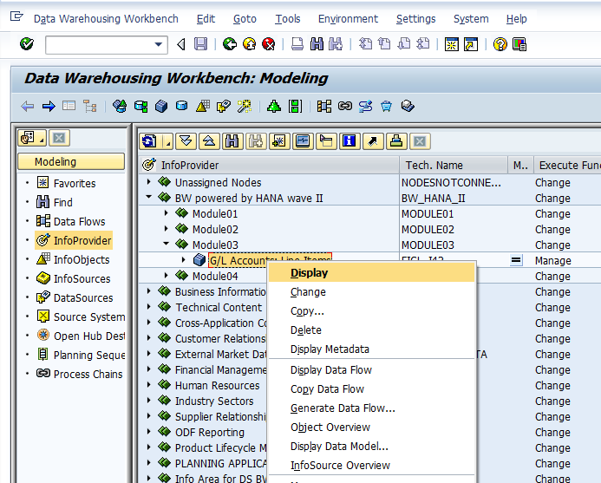
Determine the size consumed by the InfoCube tables
To determine how large the InfoCube is within the original BW environment, the help of the DBA will be required.
To determine all of the tables that are part of an InfoCube, RMC on the InfoCube and choose “Display”.

Slide 20
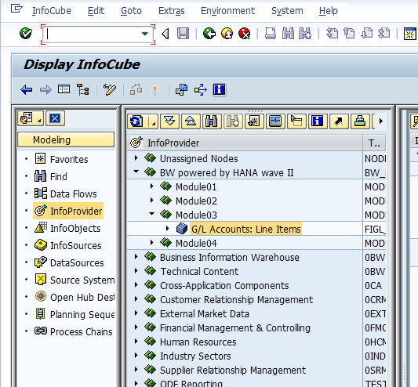
Determine the size consumed by the InfoCube tables
Select the blue “i” icon in the upper menu bar…

Slide 21
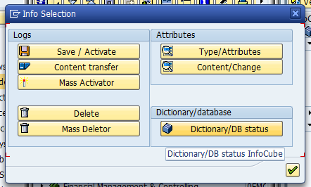
Finding the tables
Choose “Dictonary/DB status” in the bottom right of the pop-up window…

Slide 22
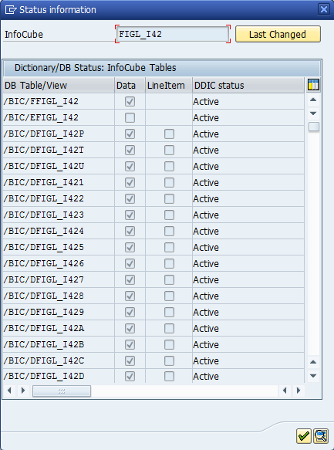
Finding the tables
All tables will be displayed, including the “F” and “E” fact tables (the first two) as well as all of the possible 16 “D” dimension tables.
The naming convention of system generated objects is as follows:
/BIC/F… Fact table
/BIC/E… Fact table
/BIC/D… Dimension table
Give all of these tables names to the DBA to determine the total size of the InfoCube tables. Record this value for each InfoCube for further evaluation.

Slide 23
Evaluating the runtime of Queries

Slide 24
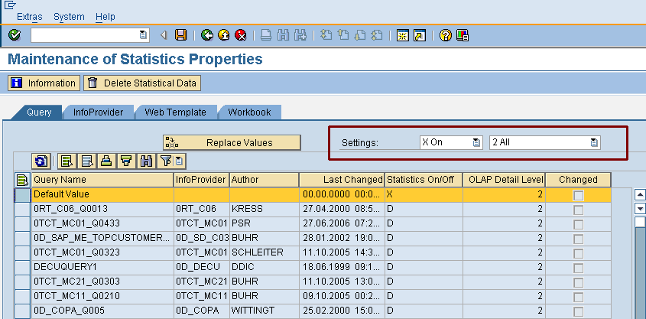
Prerequisite Pulse Check – statistics on Query/InfoCubes level
Use transaction RSDDSTAT in a BW environment to turn on /off the statistical data on a query level
If it is necessary, please change the settings to: Statistics data – on and all data
Activate this statistical information 4 weeks prior the Pulse Check will start

Slide 25
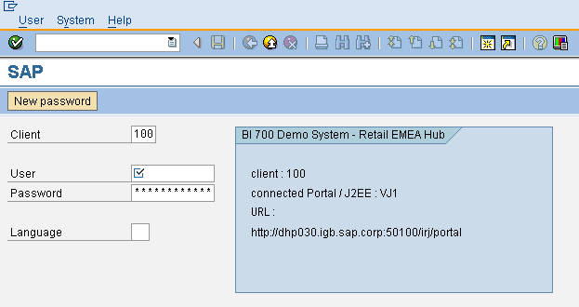
Log on to the BW system
Logon to the BW system with the user authorized for transactions RSRT, ST12, SE16, ST05, ST03, ST02, RSRCACHE, RSDDSTAT

Slide 26
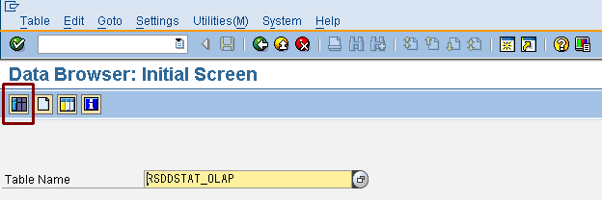
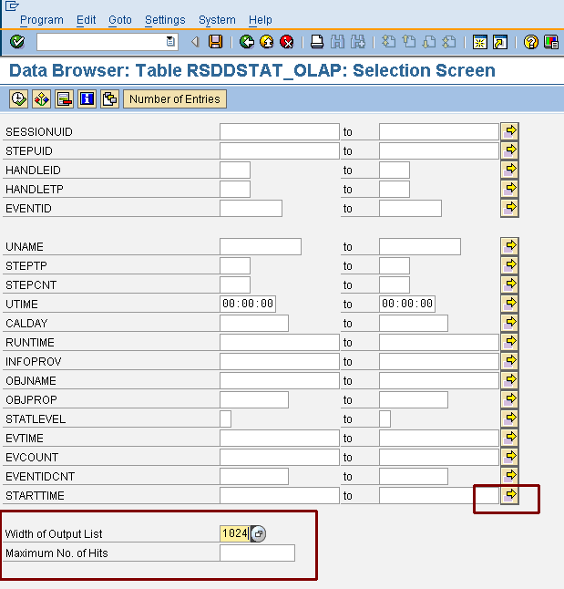
Query Performance – which queries are performance critical regarding OLAP time
Open transaction SE16 and choose RSDDSTAT_OLAP as the table name
Press the table content button or F7
Maintain the fields: width of output list – set 1024 and clear the field maximum No. of Hits
Press the multiple selection field in the start time and maintain it

Slide 27
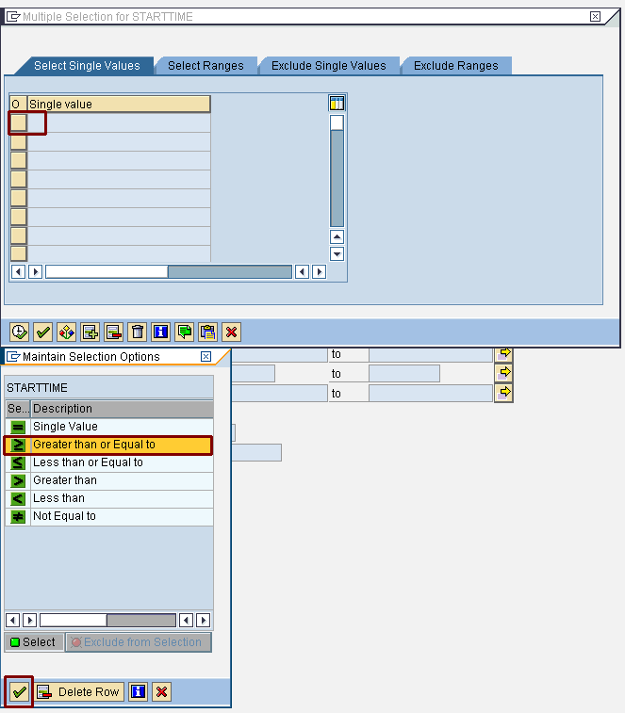
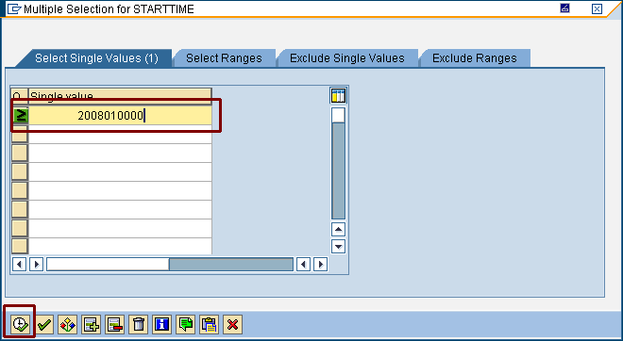
Query Performance – maintain selection view of table RSDDSTAT_OLAP
Choose the left button on the select single values tab -> use the selection option ‘greater than or equal to’ and execute
Maintain the STARTTIME -> for the last 6 month –> YYYYMMDDHHMMSS -> e.g. 20120101000000 and execute
Ensure that Greater than/equal to is selected to the left of the value
1
2
4
3
5

Slide 28
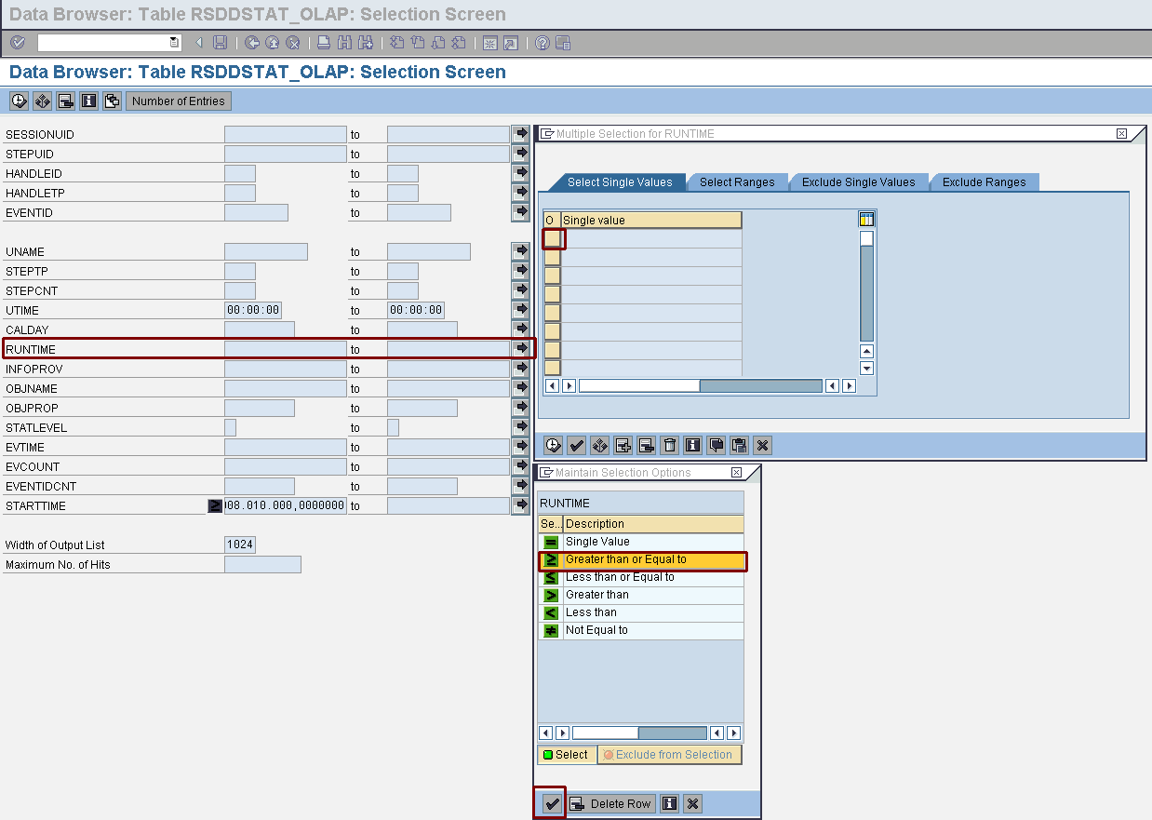
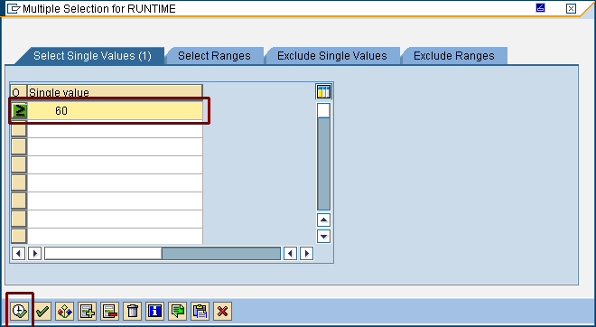
Query Performance – maintain selection view of table RSDDSTAT_OLAP part II
Prepare the runtime in the same way –> choose 60 seconds as default
2
1
3
5
4
6

Slide 29
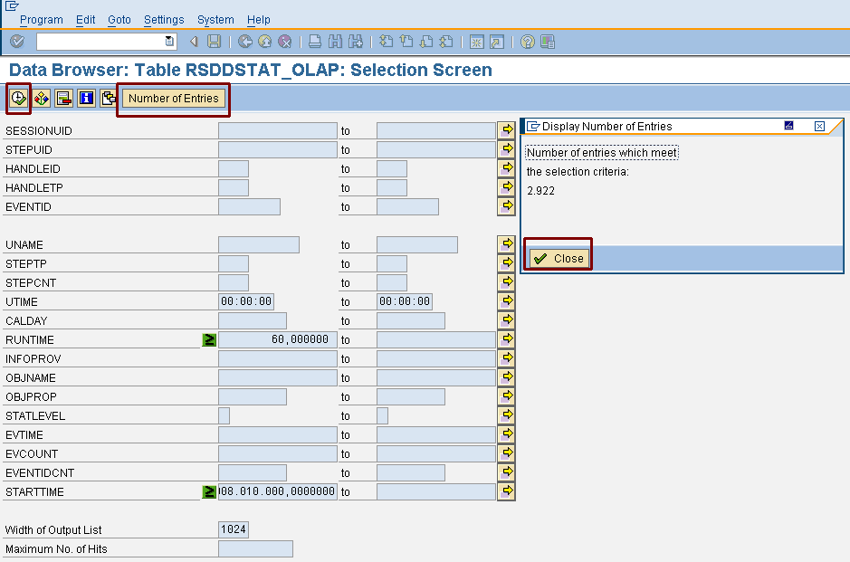
Query Performance – maintain selection view of table RSDDSTAT_OLAP part III
check if the selection parameters are working –> otherwise change the parameters (e.g. runtime to 30) for a valid result
execute the selection query

Slide 30
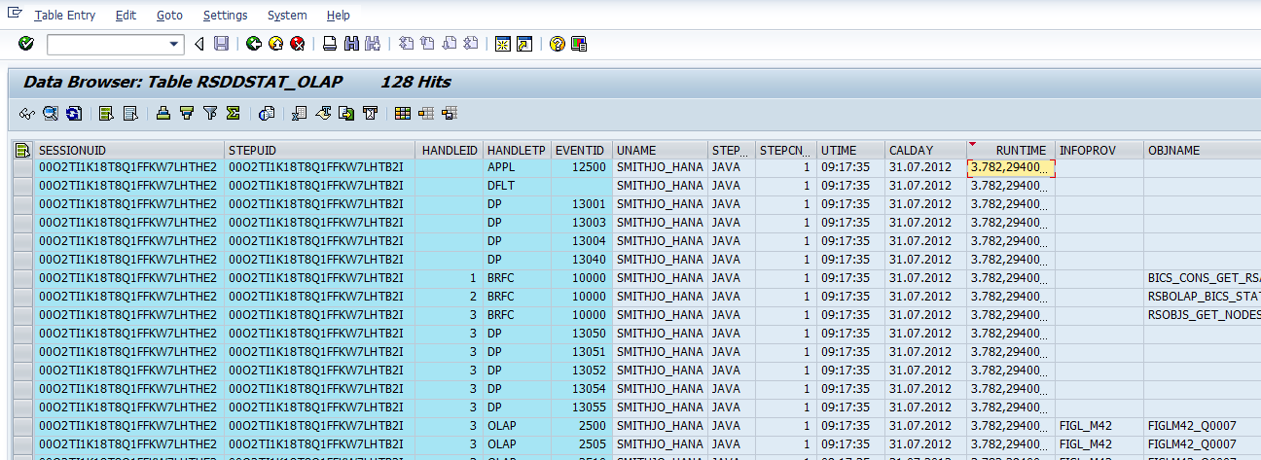
Query Performance – overview of the queries which have the highest OLAP time
to sort the runtimes descending -> put your cursor in the runtimes field and press the seventh icon from the left side
export and save the OLAP runtime list to Excel (fifth icon from the right) – see next page

Slide 31
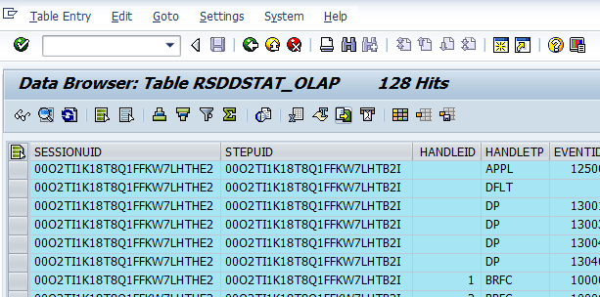
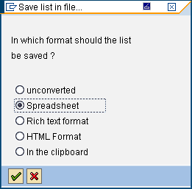
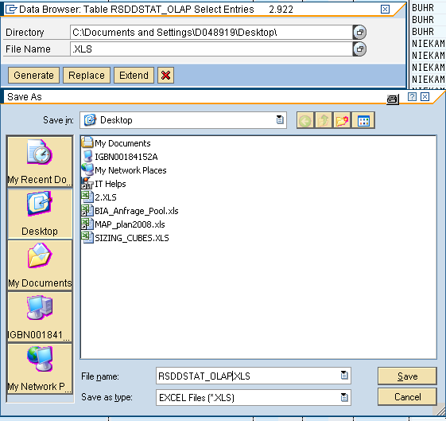
OLAP runtime list to Excel
1
choose Local File (fifth icon from right)-> and decide for the Spreadsheet option to save the runtime list
select a directory and choose a filename like RSDDSTAT_OLAP.xls and press the save button
use generate to transfer the list to Excel
2
4
3
7
5
6

Slide 32
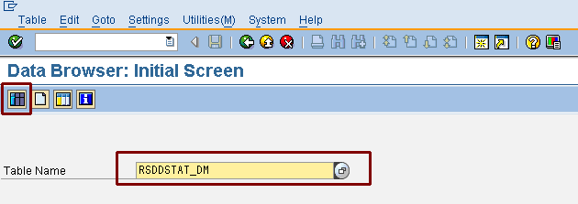
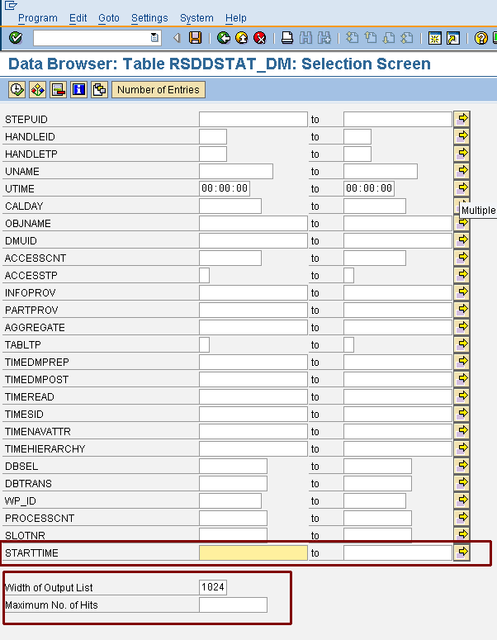
Query Performance – identify the queries with high database runtimes
open transaction SE16 and choose RSDDSTAT_DM as the table name
press the table content button or F7
maintain the fields: width of output list – set 1024 and clear the field maximum No. of Hits
press the multiple selection field in the starttime and maintain it

Slide 33
Query Performance – maintain selection view of table RSDDSTAT_DM
choose the left button in the ‘select single values’ tab -> use the selection ‘option greater than or equal’ and execute
maintain the STARTTIME -> for the last 6 month –> YYYYMMDDHHMMSS -> e.g. 20120101000000 and execute
1
2
4
3
5

Slide 34
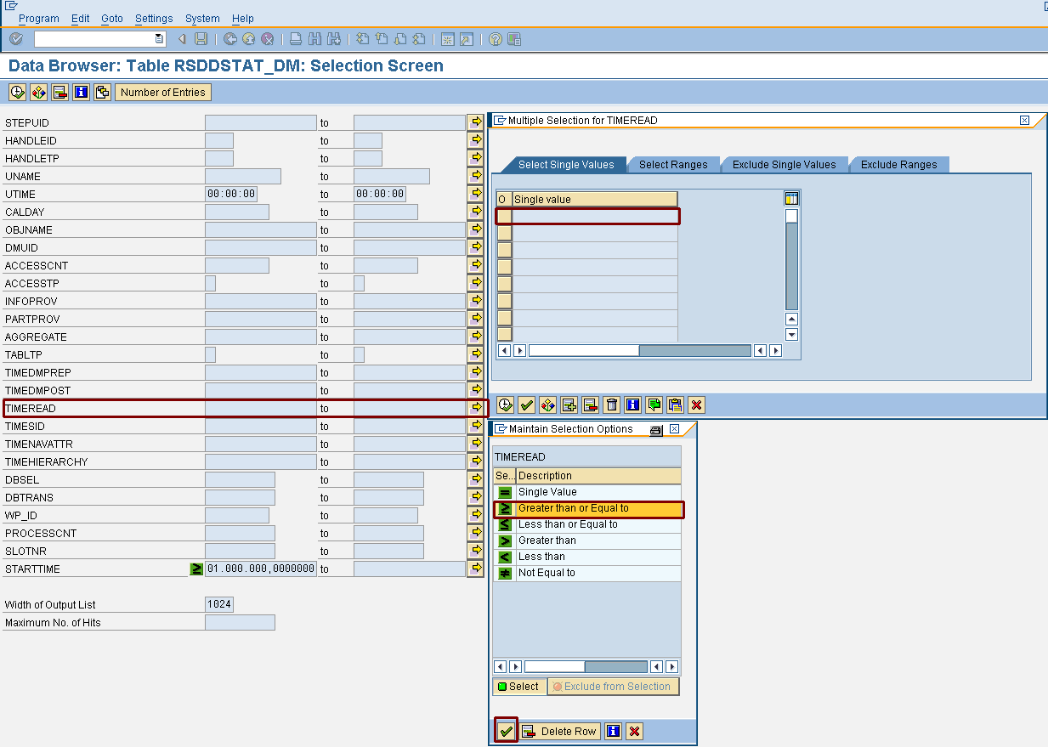
Query Performance – maintain selection view of table RSDDSTAT_DM part II
prepare the runtime in the same way –> chose 20 seconds as default
2
1
3
5
4
6

Slide 35
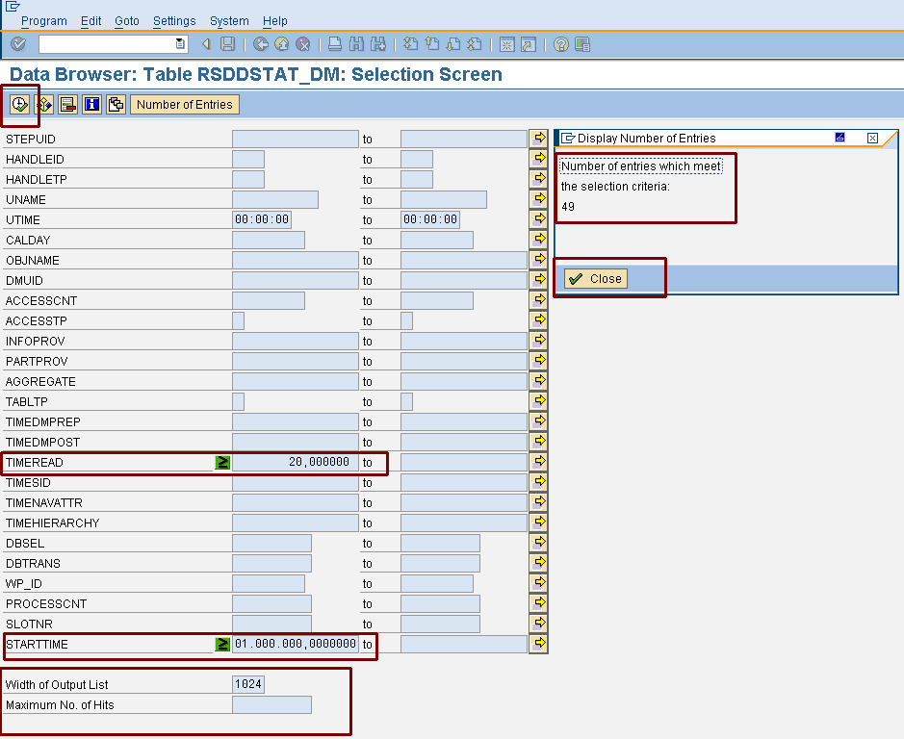
Query Performance – maintain selection view of table RSDDSTAT_DM part II
check if the selection parameters are working –> otherwise change the parameters (e.g. runtime to 15) for a valid result
execute the selection query

Slide 36
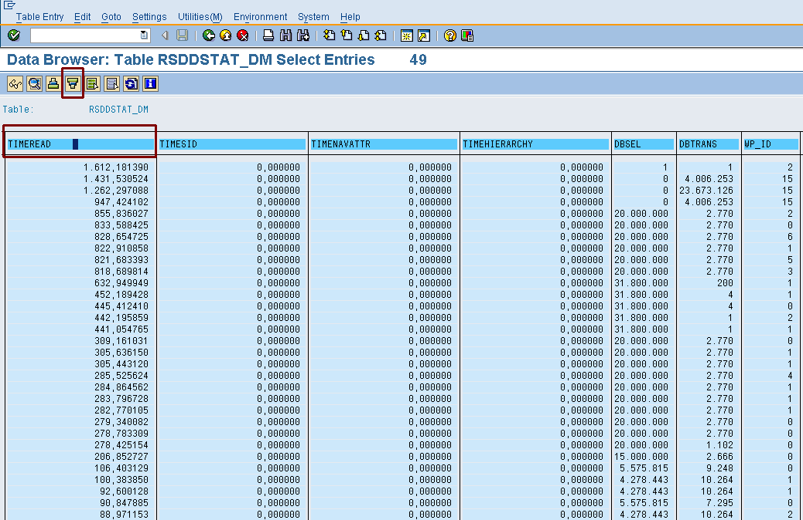
Query Performance – queries which have the highest database runtimes
to sort the runtimes descending -> put your cursor in the runtimes field and press the fourth button of the left side
export and save the Database runtime list to Excel

Slide 37
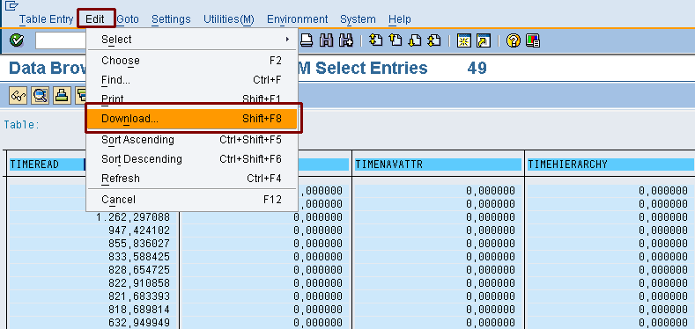
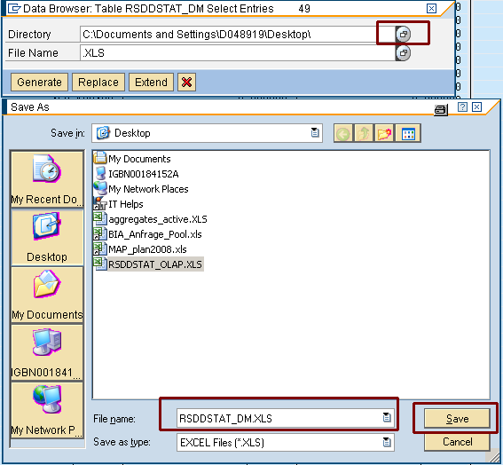
Database runtime list to Excel
1
choose Edit -> download -> and decide for the Spreadsheet option to save the runtime list
select a directory and choose a filename like RSDDSTAT_DM.xls and press the save botton
use generate to transfer the list to Excel
4
2
3
7
5
6

Slide 38
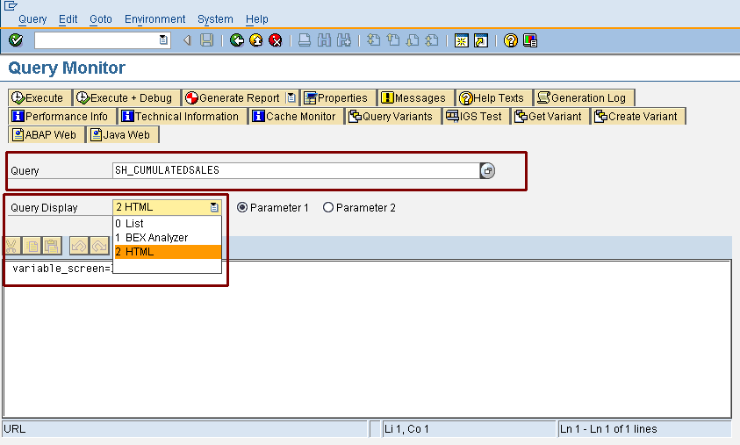
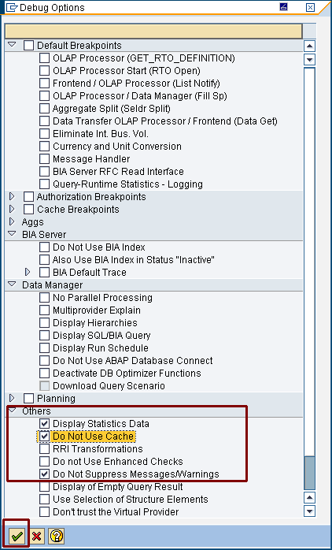
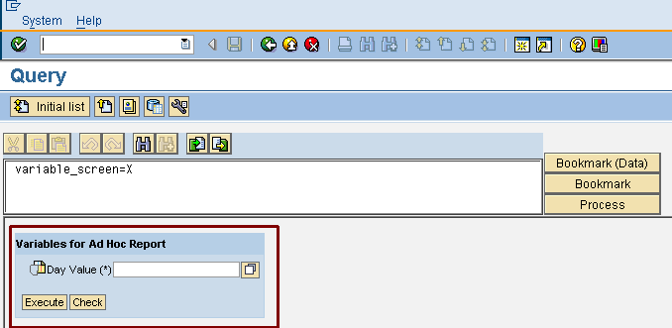
Detailed Query Analysis in RSRT
use the prepared list from the customer with the 10 most important queries
go to Transaction RSRT for deep query analysis
enter the technical name of the query and use HTML to display the query results
go to tab ‘execute and debug’ and choose ‘Display Statistics Data’ and ‘Do Not Use Cache’ then execute the Query
if there is an input prompt please ask a business user from the customer for a possible entry

Slide 39
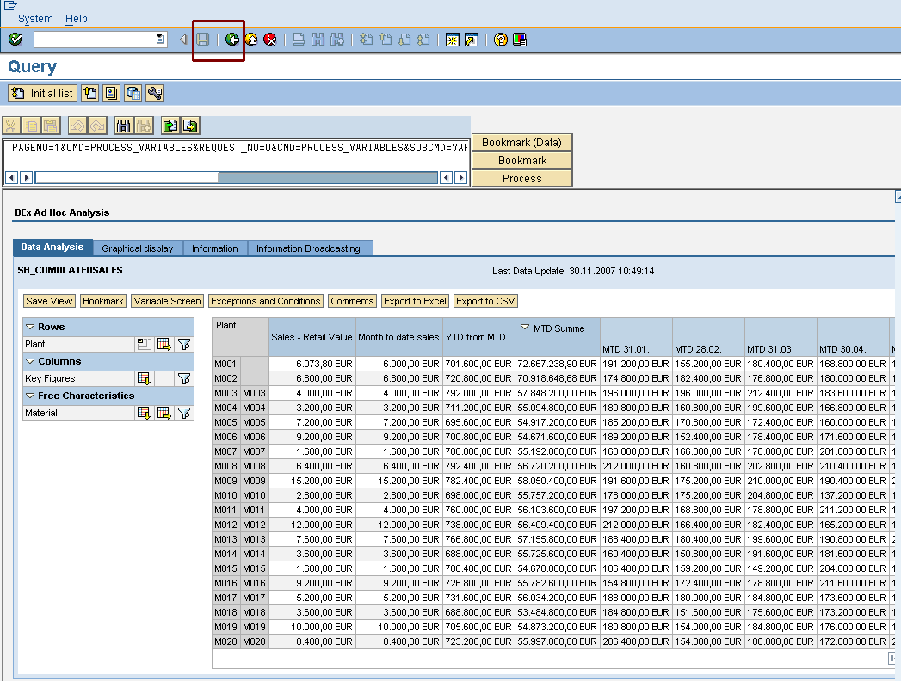
Detailed Query Analysis in RSRT – statistical data
the query result will be shown
go back to see the statistical information

Slide 40
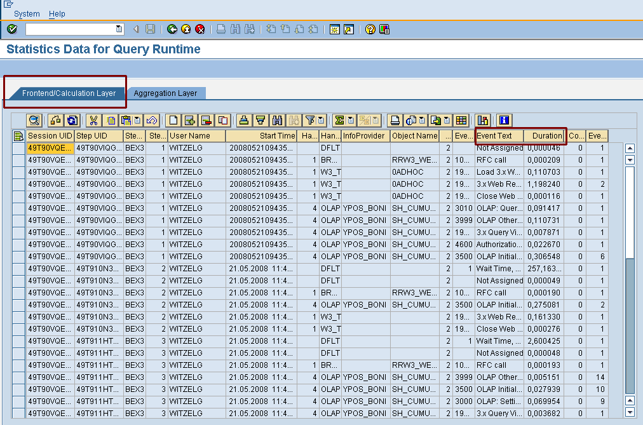
Detailed Query Analysis in RSRT – statistical data
go to the first tab -> Frontend/ Calculation Layer and export the information to Excel

Slide 41
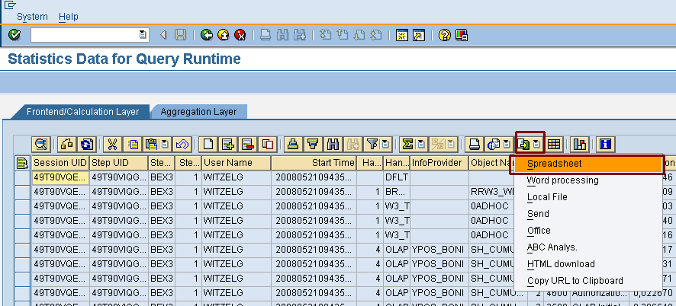
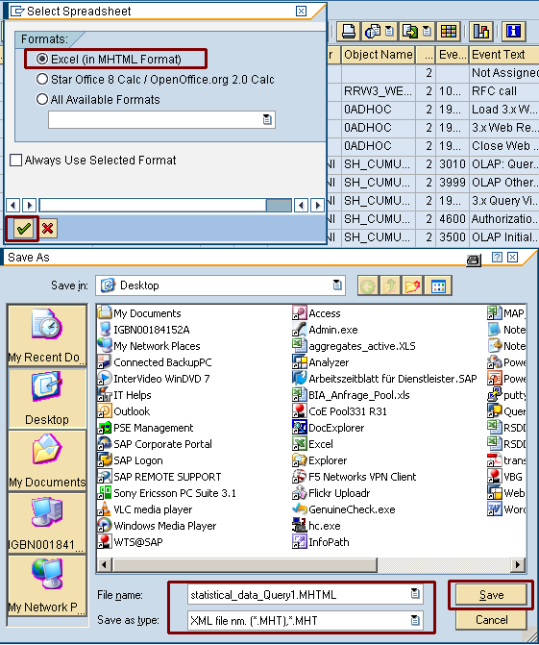
Detailed Query Analysis in RSRT – statistical data to Excel
to export the results to Excel -> Export (fourth button of the right side) -> use spreadsheet
choose Excel (MHTMLFormat) and press enter
go to the right directory and select a filename like Frontend_Statistical_<name of the first Query>.MHTML

Slide 42
Analysis of the runtimes in Excel
analyze the Excel sheet – sum the duration time
look on the events xxxxxx at the duration time
if the duration time of all events xxxxx is higher then all other times the BW on HANA will provide a significant improvement
prepare a list of the event xxxxx times in comparison to the other event times

Slide 43
Detailed Query Analysis in RSRT – statistical data to Excel
go to the second tab -> Aggregation Layer and export the information to Excel

Slide 44
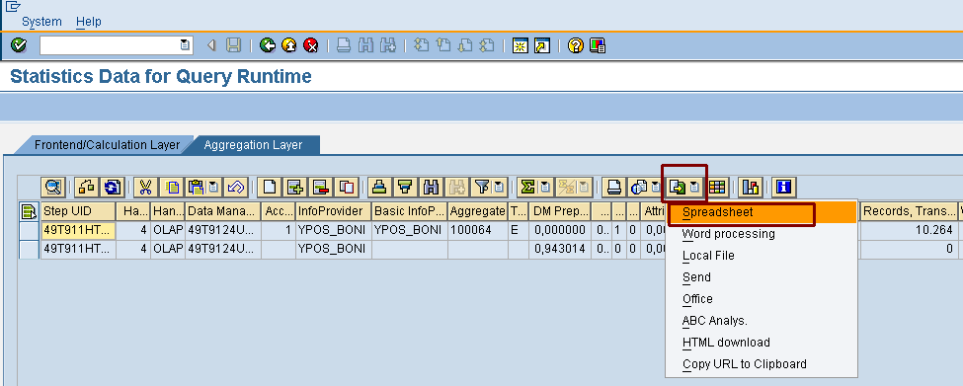
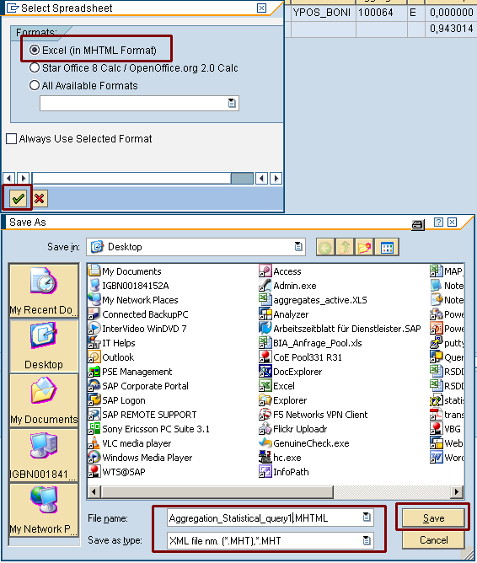
Detailed Query Analysis in RSRT – statistical data to Excel
to export the results to Excel -> Export (fourth button of the right side) -> use spreadsheet
choose Excel (MHTMLFormat) and press enter
go to the right directory and select a filename like Aggregation_Statistical_<name of the first Query>.MHTML

Slide 45
Analysis of the selected and transported data in Excel
analyze the Excel sheet – sum the ‘records selected’ and the ‘records transported’
repeat the RSRT analysis for each query from the customers most important query list
prepare an Excel sheet for each query and save the result

Slide 46
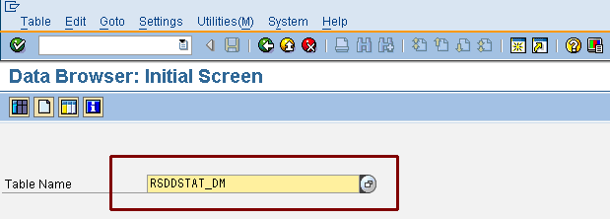
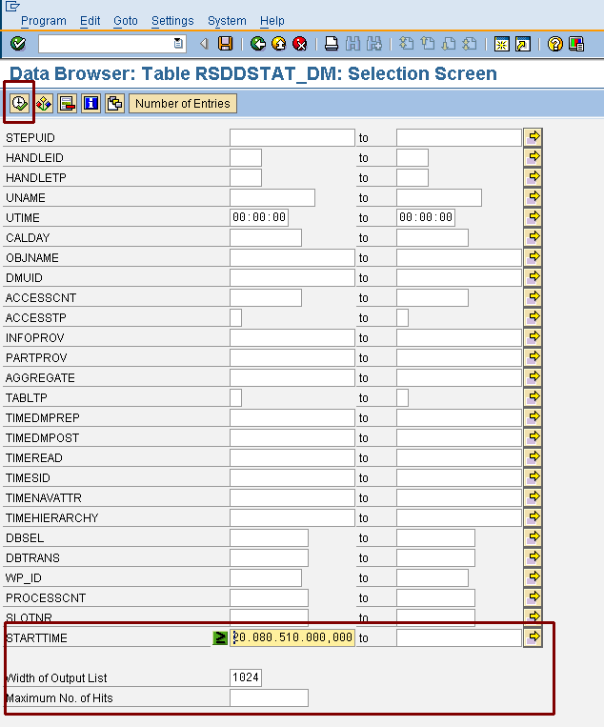
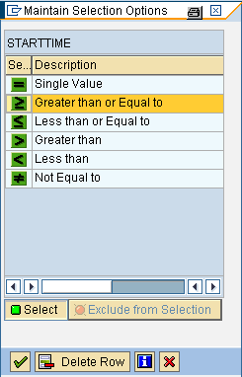
Detailed Query Analysis in RSRT – in case the customer hasn’t prepare a list of queries
go to transaction se16 and choose the table RSDDSTAT_DM
choose width of Output list – 1024 and clear the field Maximum No. of Hits
select ‘greater than or equal to’ and use the date of the last week as Starttime
execute the query and sort the runtimes for the field timeread in descending order – count the OBJNAME to get the most executions and prepare a list with this queries
or use the RSDDSTAT_DM.xls list to count the queries with the most executions and the longest runtimes in the field timeread
start performance measurement in RSRT

Slide 47
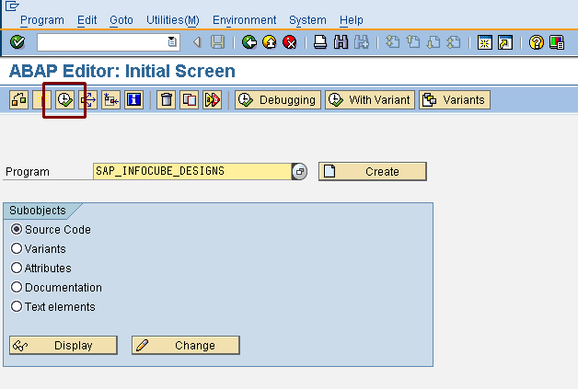
Analysis of the data model
Use transaction SE38 and maintain program name
SAP_INFOCUBE_DESIGNS
SAP_BWTOOLPGM_DB2 for Mainframe (DB2) – see note 859583 for further details
Execute this program
Press this button to
execute the program
SAP_INFOCUBE_DESIGNS

Slide 48
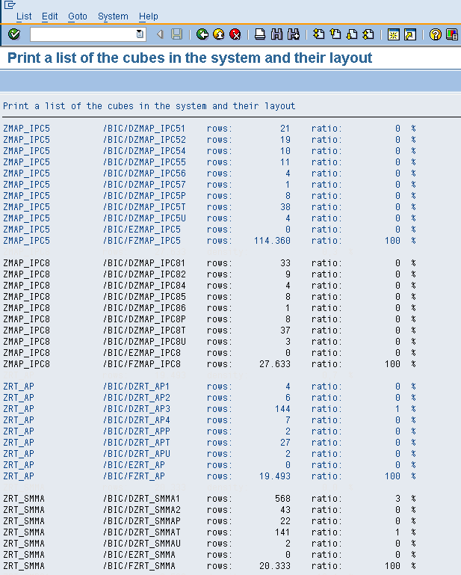
Analysis of the data model – Info Cube size
The result will be a list with all cubes in the environment which will show the dimensions, e-table and f-table entries for each cube
The most important entries are the rows in the e-table and f-table – name convention /BIC/E<Cube name> for the e-table and /BIC/F<Cube name> for the fact table
export this list as a spreadsheet to excel

Slide 49
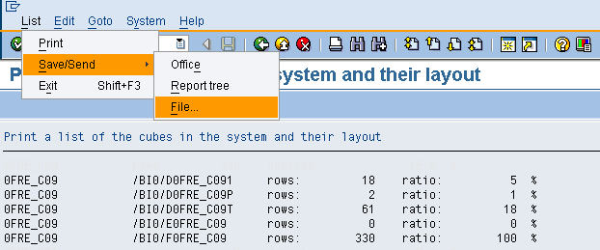
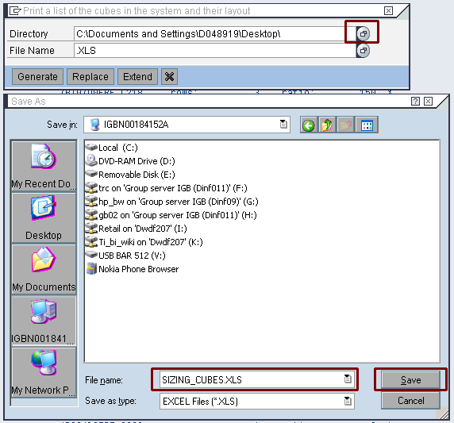
Info Cube size report to Excel
To save your results press -> LIST -> save/send -> FILE
Choose the requested format (e.g. spreadsheet for excel) and execute
Choose a directory and assign a file name like Company_Name_sizing_Cubes.xls –> press save
Now press generate and the spreadsheet will be created
1
4
2
3

Slide 50
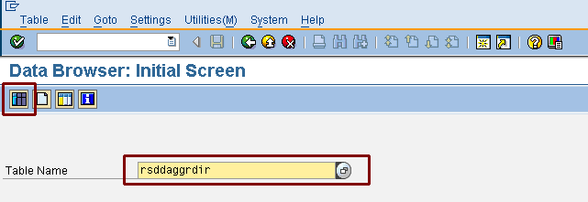
Analysis of the data model – aggregates
Identify how many aggregates are used – open transaction SE16 and choose the table RSDDAGGRDIR
Press the button table contents or F7
Maintain the selection screen -> Use version a – Active and execute the query

Slide 51
Analysis of the data model – export a list of aggregates to Excel
1
Export the list to excel and choose a directory and select a name like Company_Name_aggregates_active.xls
Note: this is a list of active aggregates – to get a list of active and filled (data containing) aggregates, please do it again and choose RNSID_TO > 0 in the table rsddaggrdir
2
3
4
5
6

Slide 52
Analysis of the data model – export a list of filled aggregates to Excel
Identify how many aggregates are active and filled – open transaction SE16 and choose the table rsddaggrdir
Press the button table contents or F7
Maintain the selection screen -> use version a – Active and execute the query
Maintain the field RNSID_TO > 0 to identify all filled aggregates
2
1
3
4
5
8
6
9
7

Slide 53
Thank You!

