Slide 1
Regional reporting. Oct 2014.

Slide 2
Purpose.
Regional reports showing the data pertinent to their business
Data is updated for start of day in the region
Reports and Analysis in other regions are not affected by loading.

Slide 3
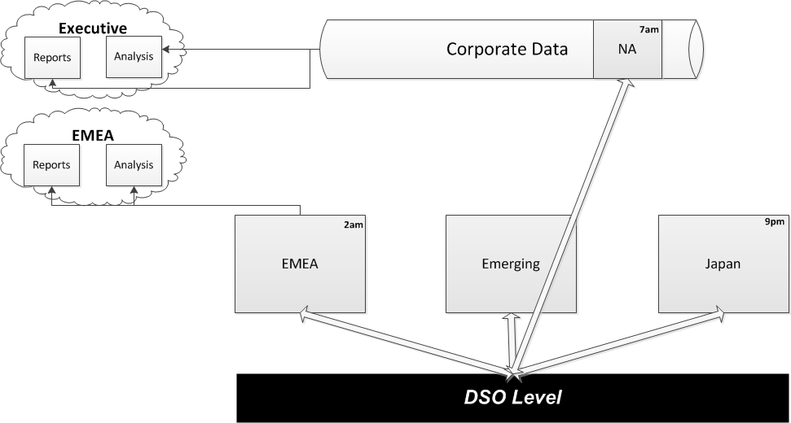
Data structure.

Slide 4
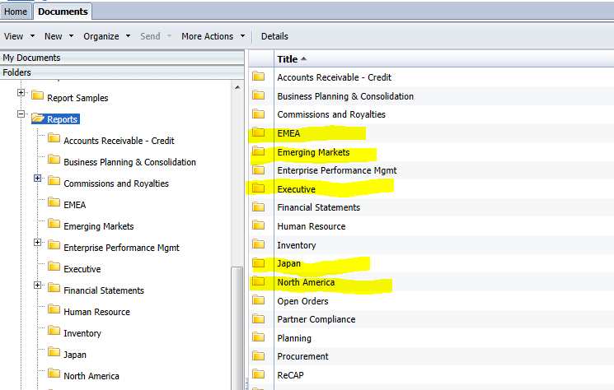
Folder Structure.

Slide 5
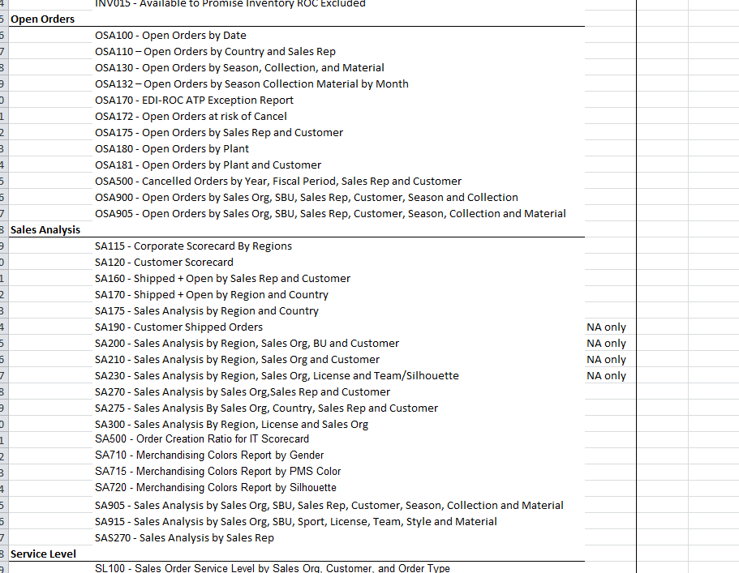
Reports.

Slide 6
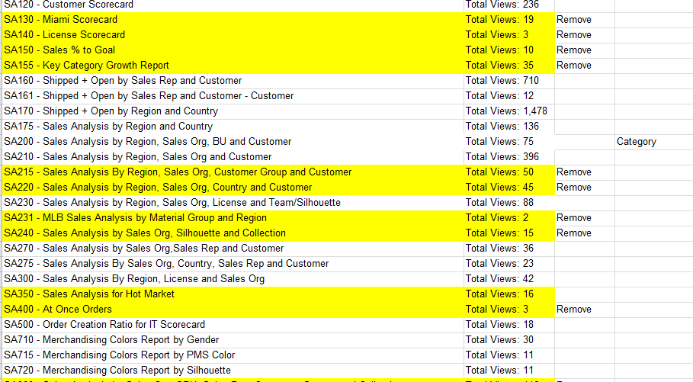
Audit.

